Slide 1
NOISE POLLUTION MONITORING
USING IOT
PROJECT PHASE – 04
Building your project by developing the platform as per project requirement using web development technologies.
TEAM MEMBERS:
1.Mohan Krishna
2.Yeswanth
3.Pavan Kumar
4.Vignesh Kumar
5.Shaik Kaif

Slide 2
Introduction :
Noise pollution is a growing problem in many parts of the world, with adverse effects on human health and well-being.
It can cause hearing loss, sleep disturbances, stress, and cardiovascular disease.
It can also interfere with communication, learning, and concentration.
The Internet of Things (IoT) offers a promising solution for monitoring and detecting noise pollution.
IoT devices can be deployed in various locations to collect real-time noise data.
This data can then be transmitted to a central server for analysis and visualization.

Slide 3
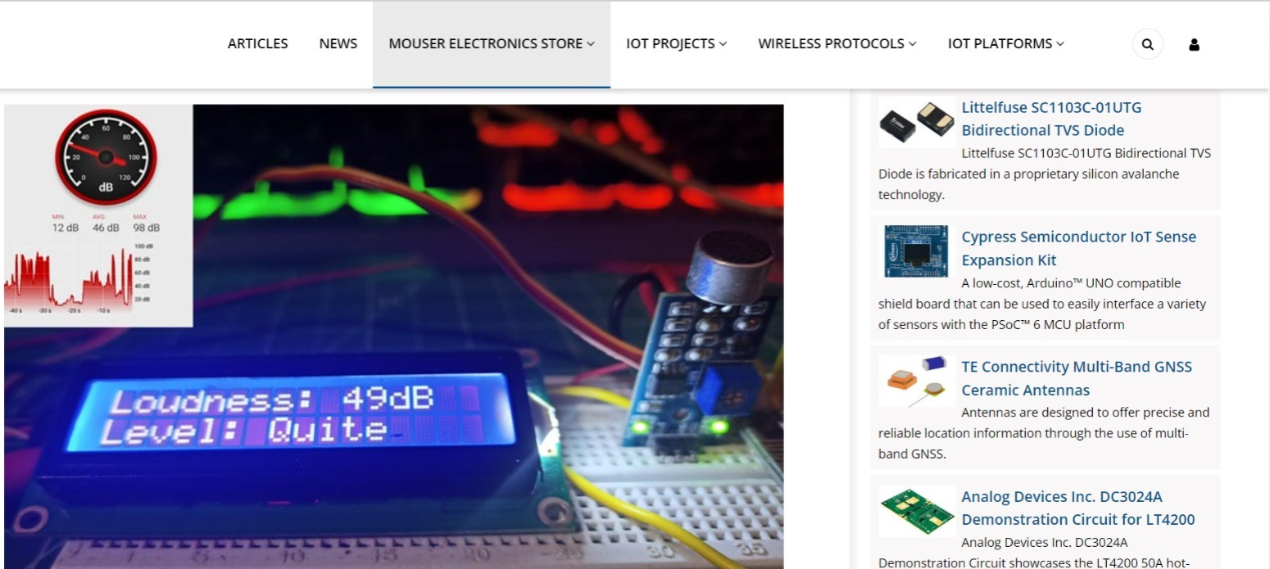
NOISE POLLUTION MONITORING :

Slide 4
NOISE POLLUTION MONITORING:
Noise pollution monitoring is the systematic process of measuring, recording, and assessing sound levels in various environments to understand the extent of noise pollution and its potential impact on human health and the surrounding ecosystem.
NOISE POLLUTION MONITORING
Identify sources of noise pollution.
Assess the impact of noise pollution on human health and the environment.
Monitor compliance with noise regulations.
Evaluate the effectiveness of noise control measures.

Slide 5
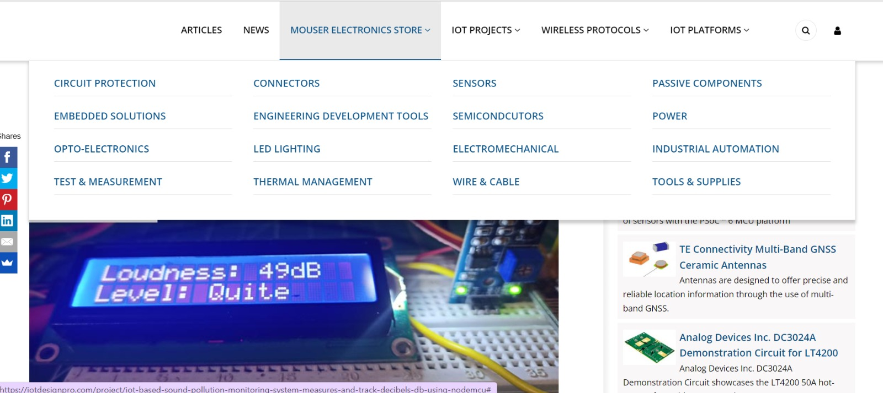
MOUSER ELECTRONICS:

Slide 6
Mouser Electronics :
Mouser Electronics is a global authorized distributor of semiconductors and electronic components for over 1,200 industry-leading manufacturer brands.
Mouser stocks the world's widest selection of semiconductors and electronic components, with over 6.8 million products in stock and ready to ship.
Mouser specializes in the rapid introduction of the newest products and technologies, targeting the design engineer and buyer communities.
Mouser has 27 offices located around the globe, and conducts business in 21 different languages and 34 currencies.

Slide 7
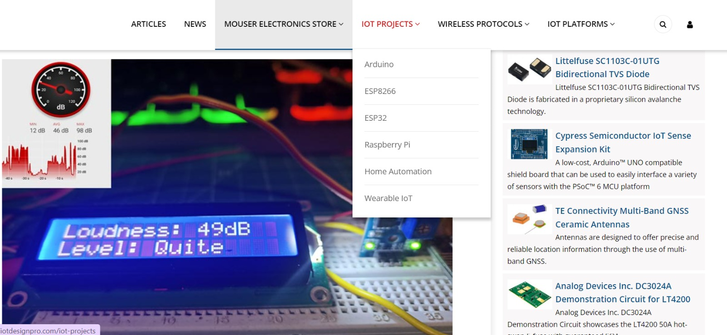
IOT PROJECT :

Slide 8
IOT PROJECT :
An IoT project is any project that involves building or using devices that are connected to the internet and can collect, share, and analyze data.
IoT projects can be simple, such as building a smart light switch, or complex, such as developing a smart city system.
Benefits of IOT projects:
1.Increased Efficiency
2.Reduced Costs
3.Improved Decision Making

Slide 9
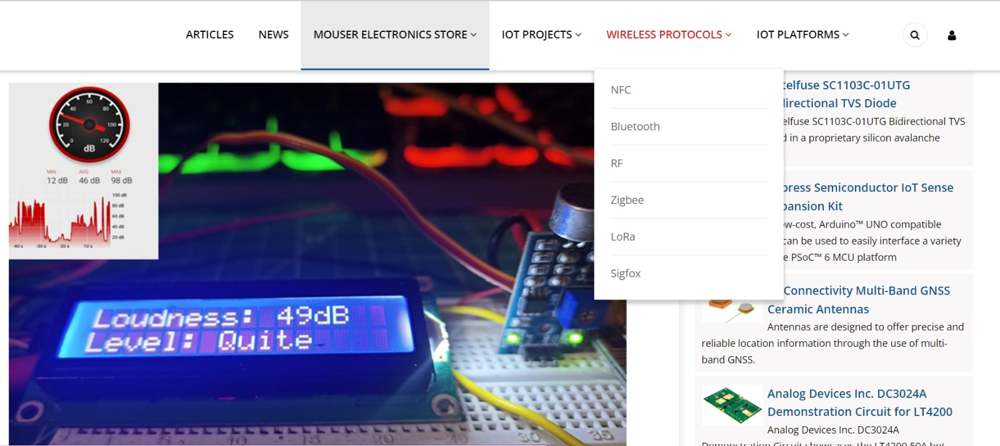
WIRELESS PROTOCOLS :

Slide 10
WIRELESS PROTOCOL :
Examples Of Wireless Protocol :
1. Wifi
2.Bluetooth
3.Cellular Network
4.Satellite communication
A wireless protocol is a set of rules that define how devices communicate with each other over a wireless network.
Wireless protocols are used in a wide range of applications, including Wi-Fi, Bluetooth, cellular networks, and satellite communications.
Wireless protocols typically consist of two main components: a physical layer and a medium access control (MAC) layer.
The physical layer defines how radio waves are used to transmit and receive data.

Slide 11
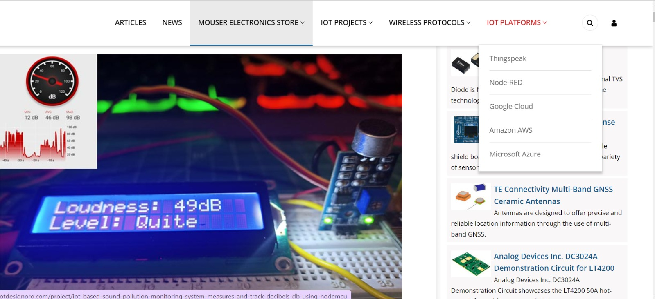
IOT PLATFORM :

Slide 12
IOT PLATFORMS:
Device management:
IoT platforms allow users to provision, configure, and manage IoT devices. This includes features such as device registration, authentication, and authorization.
Data collection and storage:
IoT platforms collect data from IoT devices and store it in a secure and scalable data warehouse. This data can then be analyzed to gain insights into device performance, operational efficiency, and customer behavior.
Data analytics:
IoT platforms provide a variety of data analytics tools to help users extract insights from their IoT data. This includes tools for data visualization, machine learning, and artificial intelligence.
Application development:
IoT platforms provide tools and libraries to help developers build IoT applications. This includes tools for developing mobile apps, web apps, and cloud-based applications.

Slide 13
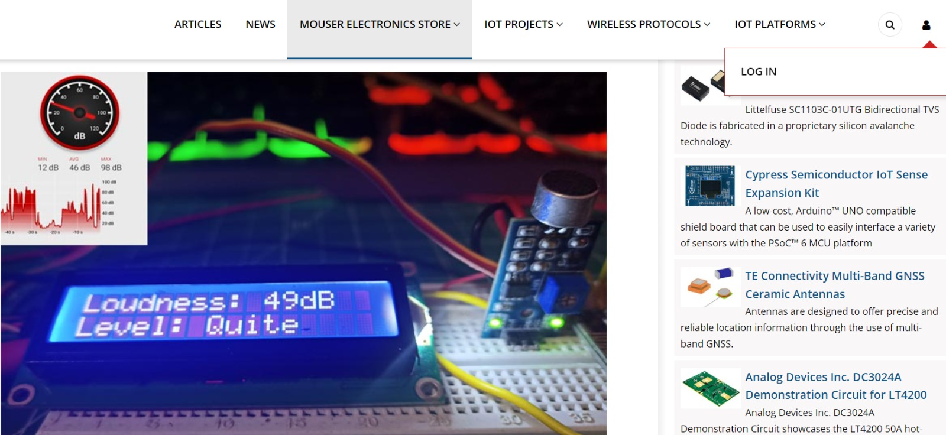
LOGIN PAGE:

Slide 14
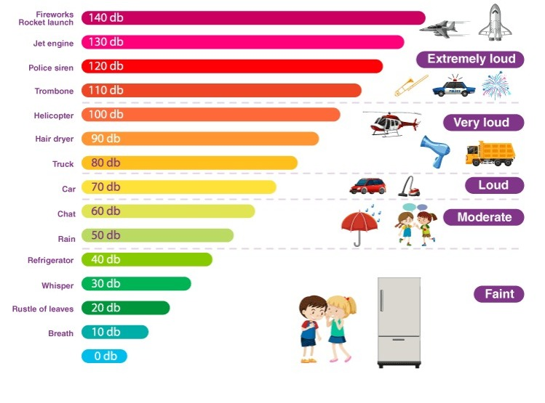
Types of Noise Pollution:
1.Transport Noise
2.Neighbourhood Noise
3.Industrial Noise

Slide 15
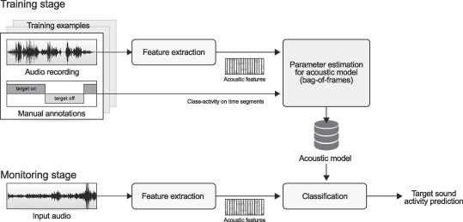
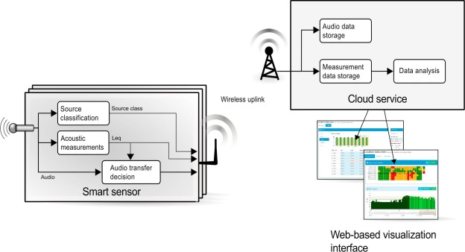
OUTLINE OF NOISE POLLUTION MONITORING:

Slide 16
Advantages:
1.Low initial cost.
2.Easy to design.
3.Low pressure drop.
4. Low maintenance cost.
5.High collection efficiency.
Disadvantages:
1.Requires large space.
2.Less collection efficiency.
3.Only larger size particles can be collected.
4.Space requirement is more.
5.Requires high voltage.

Slide 17
Conclusion:
IoT-based noise pollution monitoring systems offer a number of advantages over traditional noise monitoring systems.
These systems are real-time, remote, scalable, and affordable. IoT-based noise pollution monitoring systems can be used to identify noise sources, assess noise impact, monitor compliance, and evaluate noise control measures.
Overall, IoT-based noise pollution monitoring systems are a valuable tool for managing noise pollution and protecting human health and the environment.
THANK YOU

